Slide 1

Noida Institute of Engineering and Technology, Gr. Noida
Union Executive & State Executive
Unit: 2
Constitution of India, Law & Engineering
Mr. Ajeet Singh
Assistant Professor, Department of ME
Course Details (B. Tech 5th Semester)

Slide 2

Faculty Biodata
Faculty Name: Ajeet Singh
Designation: Assistant Professor (Department of
Mechanical Engineering)
Area of Interest: Automation, Artificial Intelligence,
Mechatronics.
Educational Qualification:
B.Tech- Mechanical & Automation Engineering (Amity University U.P.)
M.Tech- Production Technology (Vinobha Bhave University J.H.)

Slide 3

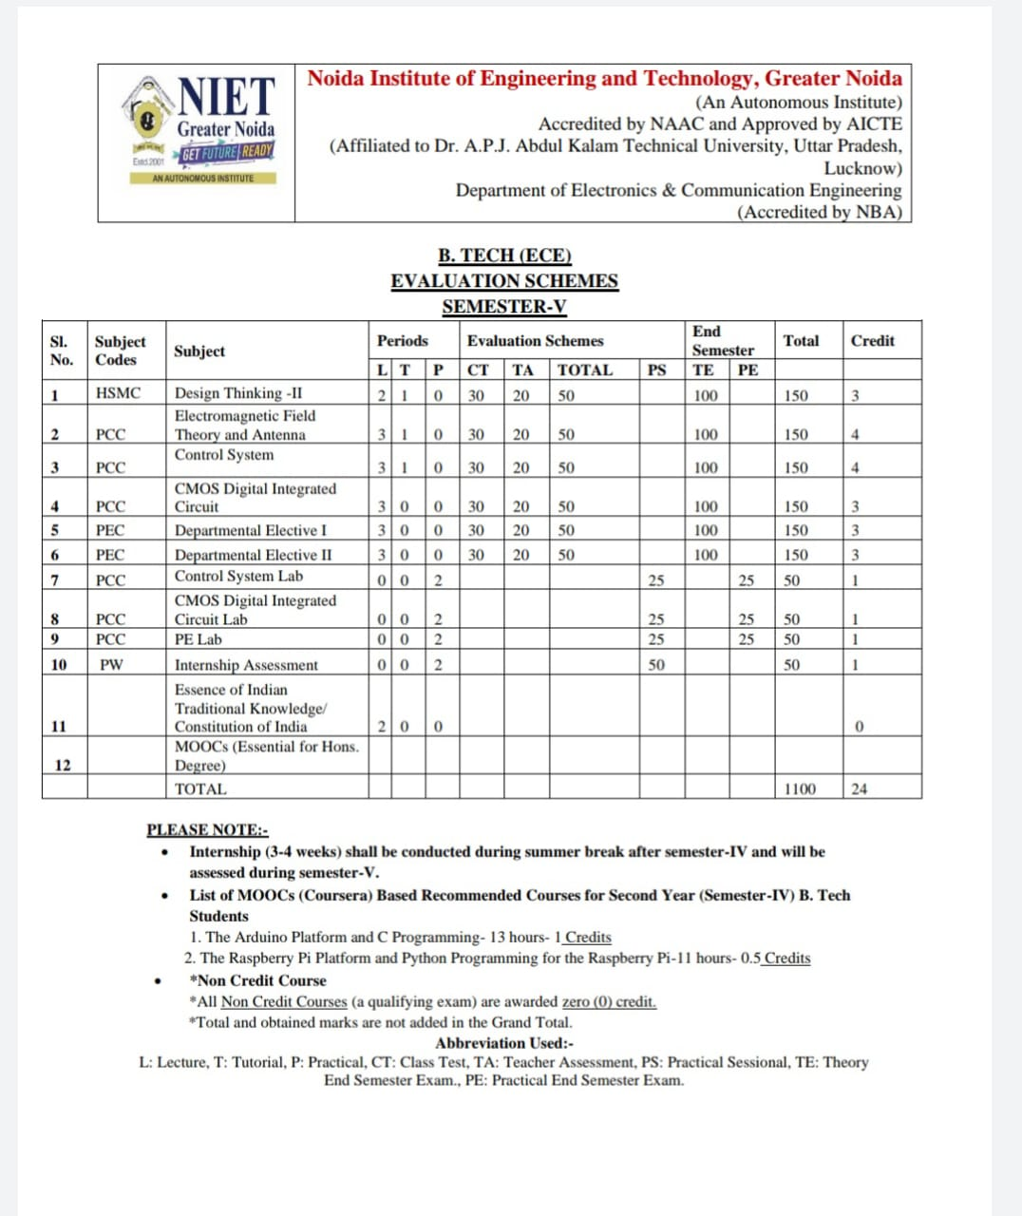
Evaluation Scheme

Slide 4

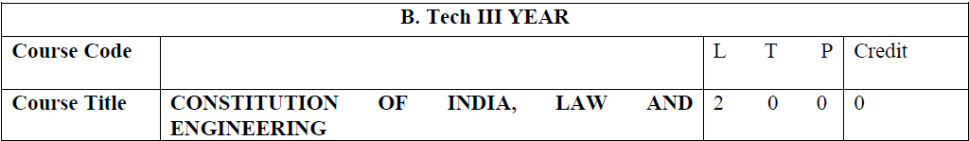
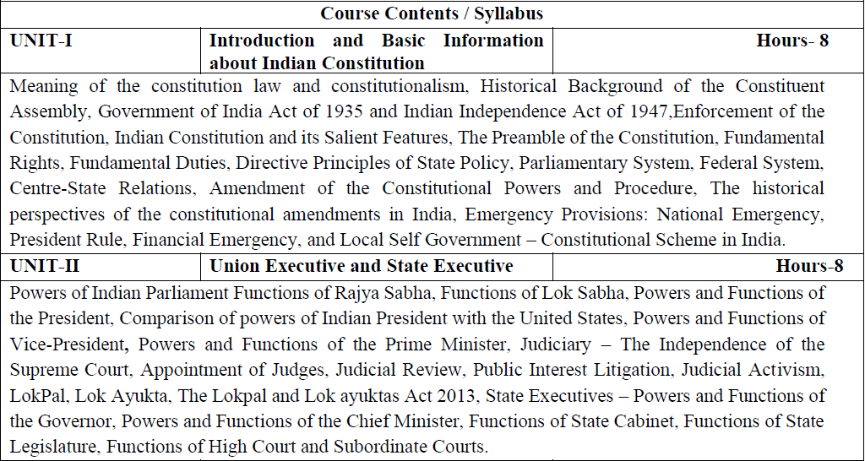
Syllabus

Slide 5

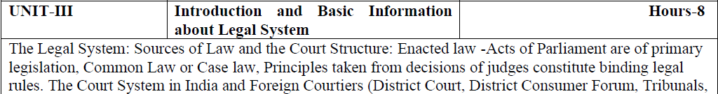
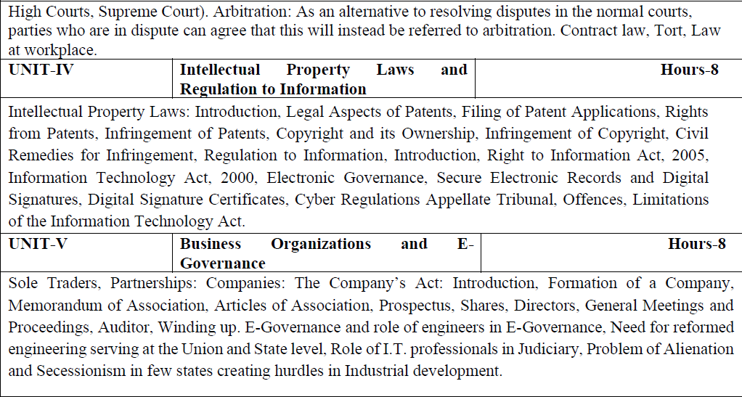
Syllabus

Slide 6

Branch wise Applications
Legal knowledge
Individual rights
Duties of a citizen
Patient filling
Business setup

Slide 7
Course Objectives
Course Objectives:
The student will try to learn about:
To acquaint the students with legacies of constitutional development in India and help those to understand the most diversified legal document of India and philosophy behind it.
To make students aware of the theoretical and functional aspects of the Indian Parliamentary System.
To channelize students’ thinking towards basic understanding of the legal concepts and its implications for engineers.
To acquaint students with latest intellectual property rights and innovation environment with related regulatory framework.
To make students learn about role of engineering in business organizations and e-governance.

Slide 8
Course Outcome (CO)
Course Outcome:
After successful completion of the course students will demonstrate the ability to
CO1: Identify and explore the basic features and modalities about Indian constitution.
CO2: Differentiate and relate the functioning of Indian parliamentary system at the center and state level.
CO3: Differentiate different aspects of Indian Legal System and its related bodies.
CO4: Discover and apply different laws and regulations related to engineering practices.
CO5: Correlate role of engineers with different organizations and governance models

Slide 9

Program Outcomes
Program Outcomes are narrow statements that describe what the students are expected to know and would be able to do upon the graduation.
These relate to the skills, knowledge, and behavior that students acquire through the programmed.
Engineering knowledge
Problem analysis
Design/development of solutions
Conduct investigations of complex problems
Modern tool usage
The engineer and society
Environment and sustainability
Ethics
Individual and team work
Communication
Project management and finance
Life-long learning

Slide 10
CO-PO Mapping
COs | POs | PO1 | PO2 | PO3 | PO4 | PO5 | PO6 | PO7 | PO8 | PO9 | PO10 | PO11 | PO12
CO1 |  | - | - | - | - | - | - | - | 3 | - | - | - | 3
CO2 |  | - | - | - | - | - | - | - | 3 | - | - | - | 3
CO3 |  | - | - | - | - | - | - | - | 3 | - | - | - | 3
CO4 |  | - | - | - | - | - | - | - | 3 | - | - | - | 3
CO5 |  | - | - | - | - | - | - | - | 3 | - | - | - | 3
Average |  | - | - | - | - | - | - | - | 3 | - | - | - | 3
Note: Correlation levels are taken 1, 2 and 3 as defined below:
1: Slight (Low) 2: Moderate (Medium) 3: Substantial (High)
If there is no correlation, put ‘-’

Slide 11
Program Specific Outcomes
Program Specific Outcomes (PSOs) are what the students should be able to do at the time of graduation. The PSOs are program specific. PSOs are written by the department offering the program.
PSO1: To apply the knowledge of mathematics, science and electronics & communication engineering to work effectively in the industry based on same or related area.
PSO2: To use their skills to work in modern electronics & communication engineering tools, software and equipments to design solutions for complex problems in the related field that meet the specified needs of the society.
PSO3: To function effectively as an individual and as a member or leader of a team by qualifying through examinations like GATE (Graduate Aptitude Test in Engineering), IES (Indian Engineering Services), PSUs (Public Sector Undertakings), TOEFL (Test of English as a Foreign Language), GMAT (Graduate Management Admission Test) and GRE (Graduate Record Examinations in US) etc.

Slide 12
CO-PSO Mapping
COs | PSOs | PSO1 | PSO2 | PSO3
CO1 |  | - | - | -
CO2 |  | - | - | -
CO3 |  | - | - | -
CO4 |  | - | - | -
CO5 |  | - | - | -
Average |  | - | - | -
Note: Correlation levels are taken 1, 2 and 3 as defined below:
1: Slight (Low) 2: Moderate (Medium) 3: Substantial (High)
If there is no correlation, put ‘-’

Slide 13
Program Educational Objectives
The Program Educational Objectives (PEOs) of an engineering degree program are the statements that describe the expected achievements of graduates in their career, and what the graduates are expected to perform and achieve during the first few years after graduation.
PEO1: To have an excellent scientific and engineering breadth so as to comprehend, analyze, design and solve real-life problems using state-of-the-art technology.
PEO2: To lead a successful career in industries or to pursue higher studies or to understand entrepreneurial endeavours.
PEO3: To effectively bridge the gap between industry and academics through effective communication skill, professional attitude and a desire to learn.

Slide 14
Result Analysis
Department wise:
OVERALL CLEAR PASS STUDENTS | 65
OVERALL PASS % | 48.51%
SUBJECT | KME501 | KME502 | KME503 | KME051 | KME055 | KAU051 | KAU052 | KME052 | KME056 | KME551 | KME552 | KME553 | KME554 | KNC501
NO.OF BACKLOGS | 30 | 47 | 7 | 1 | 3 | 8 | 16 | 0 | 10 | 0 | 0 | 0 | 0 | 0
BACKLOG % | 22.39% | 35.07% | 5.22% | 0.75% | 2.24% | 5.97% | 11.94% | 0.00% | 7.46% | 0.00% | 0.00% | 0.00% | 0.00% | 0.00%
PASS % | 77.61% | 64.93% | 94.78% | 99.25% | 97.76% | 94.03% | 88.06% | 100.00% | 92.54% | 100.00% | 100.00% | 100.00% | 100.00% | 100.00%

Slide 15
Result Analysis
Faculty wise:
AJEET SINGH | Subject 1 (KME052) [section C] | SUBJECT 2(KNC 501) [section A] | SUBJECT 2(KNC 501 [section B] | SUBJECT 2(KNC 501) [section C] | SUBJECT 2( KNC 501) [section D]
BACKLOG | 0 | 0 | 0 | 0 | 0
PASS % | 100% | 100% | 100% | 100% | 100%
Subject wise:
Subject Code | Subject Name | Total Student | Backlog Number | Pass %
KNC 502 | COILE | 135 | 0 | 100%

Slide 16
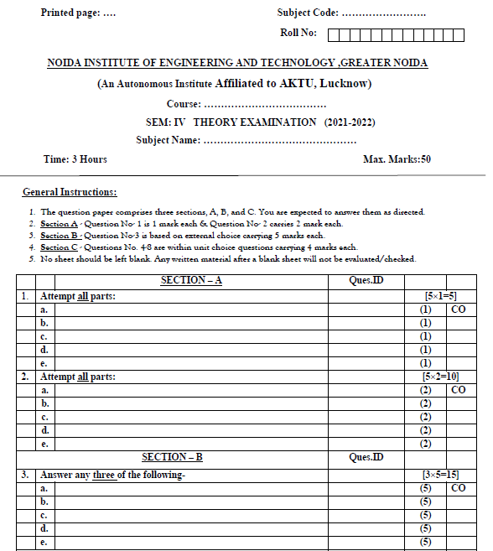
End Sem Question Paper Template

Slide 17
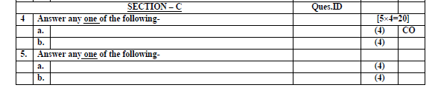
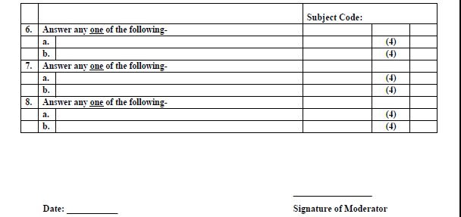
End Sem Question Paper Template

Slide 18
Prerequisite and Recap
Basic knowledge of political science.
Basic idea about society

Slide 19
Brief Subject Introduction with Video
To acquaint the students with legacies of constitutional development in India and help those to understand the most diversified legal document of India and philosophy behind it. To make students aware of the theoretical and functional aspects of the Indian Parliamentary System. To channelize students’ thinking towards basic understanding of the legal concepts and its implications for engineers. To acquaint students with latest intellectual property rights and innovation environment with related regulatory framework. To make students learn about role of engineering in business organizations and e-governance.
https://www.youtube.com/watch?v=eS03-itWEPs

Slide 20
Content (Unit 2)
Powers of Indian Parliament Functions of Rajya Sabha, Functions of Lok Sabha, Powers and Functions of the President, Comparison of powers of Indian President with the United States, Powers and Functions of Vice-President, Powers and Functions of the Prime Minister
Judiciary – The Independence of the Supreme Court, Appointment of Judges, Judicial Review, Public Interest Litigation, Judicial Activism, LokPal, Lok Ayukta, The Lokpal and Lok ayuktas Act 2013, Functions of High Court and Subordinate Courts.
State Executives – Powers and Functions of the Governor, Powers and Functions of the Chief Minister, Functions of State Cabinet, Functions of State Legislature,

Slide 21
Unit Objective
To make students aware of the theoretical and functional aspects of the Indian Parliamentary System.

Slide 22
Topic Objective/ Topic outcome
Name of Topic | Objective of Topic | Mapping with CO
Powers of Indian Parliament Functions of Rajya Sabha, Functions of Lok Sabha, Powers and Functions of the President, Comparison of powers of Indian President with the United States, Powers and Functions of Vice-President, Powers and Functions of the Prime Minister | Students will be able to learn about governance system of India | CO2

Slide 23

Indian Parliament
India is a democratic republic with a parliamentary form of government. The government at the Central level is called ‘Union Government’ and at the State level it is known as ‘State Government’.
The Union Government has three organs –
The Executive
The Legislature and
The Judiciary.
The President, the Prime Minister and his Council of Ministers collectively constitute the Union Executive.

Slide 24
Powers of Indian Parliament
Parliament is the supreme legislative body of India.
The Indian Parliament comprises of the President and the two Houses - Rajya Sabha (Council of States) and Lok Sabha (House of the People).
The President has the power to summon and prorogue either House of Parliament or to dissolve Lok Sabha.
The Constitution of India came into force on January 26, 1950. The first general elections under the new Constitution were held during the year 1951-52 and the first elected Parliament came into existence in April, 1952,

Slide 25
Powers of Indian Parliament (Continue..)
All the legislative powers of the federal Government are vested in the Parliament.
The laws framed by the Indian Parliament are enforced in the whole of the country. The Parliament of India is a bi-cameral legislature.
It consists of two houses- Rajya Sabha and Lok Sabha.
Rajya Sabha is the upper chamber of the Parliament while Lok Sabha is the lower chamber of the Parliament.

Slide 26
Powers of Indian Parliament (Continue..)
The powers and functions can be classified into the following categories: 1. Legislative powers and functions: The primary function of Parliament is law-making.
Lok Sabha plays an important part here. It can pass bills concerning the Union and Concurrent list.
No bill can be made into law unless it has been passed by Lok Sabha.
2. Executive powers and functions: Executive powers are needed in the process of implementing acts and policies in Parliament.
The Parliament can remove the Cabinet out of power.
The Parliament appoints a Committee on Ministerial Assurances who checks the promises made by the ministers to the Parliament are fulfilled or not.

Slide 27
Powers of Indian Parliament (Continue..)
3. Financial powers and functions:
Parliament enjoys supreme authority in financial matters.
It includes enactment of the budget, examining the performance of government concerning financial spending through financial committees.
4. Judicial powers and functions:
It includes impeachment of the president for violation of the constitution, removal of judges of the supreme and high court, removal of vice-president, and punish its members or outsiders for breach of privileges.

Slide 28
Powers of Indian Parliament (Continue..)
5. Electoral powers and functions:
All Parliament members participate in the election of President and Vice- President.
The members of Lok Sabha elect its speaker and deputy speaker from among its members. The Rajya Sabha elects its Deputy Chairman.
6. Constituent powers and functions:
Parliament is empowered to initiate a proposal for the amendment of the constitution.
A bill for the amendment initiated in either House of the Parliament.

Slide 29
Powers of Rajya Sabha.
Powers of Rajya Sabha are:
Legislative Powers
Financial Powers
Executive Powers
Amendment Powers
Electoral Powers
Judicial Powers
Miscellaneous Powers

Slide 30
Powers and functions of Rajya Sabha (Continue..)
1. Legislative Powers:
In the sphere of ordinary law-making the Rajya Sabha enjoys equal powers with the Lok Sabha.
An ordinary bill can be introduced in the Rajya Sabha and it cannot become a law unless passed by it.
In case of a deadlock between the two Houses of Parliament over an ordinary bill and if it remains unresolved for six months, the President can convene a joint sitting of the two Houses for resolving the deadlock.

Slide 31
Powers and functions of Rajya Sabha (Continue..)
2. Financial Powers:
In the financial sphere, the Rajya Sabha is a weak House.
A money bill cannot be introduced in the Rajya Sabha. It can be initiated only in the Lok Sabha.
A money bill passed by the Lok Sabha comes before the Rajya Sabha for its consideration.
However, if within a period of 14 days, the Rajya Sabha fails to pass the bill, the bill is taken to have been passed by the Parliament irrespective of the fact whether the Rajya Sabha has passed it or not.

Slide 32
Powers and functions of Rajya Sabha (Continue..)
3. Executive Powers:
“The Union Council of Ministers is collectively responsible before the Lok Sabha and not the Rajya Sabha.”
Lok Sabha alone can cause the fall of the Council of Ministers by passing a vote of no-confidence.
4. Amendment Powers:
Rajya Sabha and Lok Sabha can together amend the constitution by passing an amendment bill with 2/3 majority in each House.

Slide 33
Powers and functions of Rajya Sabha (Continue..)
5. Electoral Powers:
The Rajya Sabha has some electoral powers also. The elected members of the Rajya Sabha along with the elected members of the Lok Sabha and all the State Legislative Assemblies together elect the President of India.
The members of the Rajya Sabha Lok Sabha together elect the Vice- President of India.
Members of the Rajya Sabha also elect a Deputy Chairman from amongst themselves.

Slide 34
Powers and functions of Rajya Sabha (Continue..)
6. Judicial Powers:
(a) The Rajya Sabha acting along with the Lok Sabha can impeach the President on charges of violation of the Constitution.
(b) The Rajya Sabha can also pass a special address for causing the removal of a judge of the Supreme Court or of any High Court.
(c) The charges against the Vice-President can be leveled only in the Rajya Sabha.
(d) The Rajya Sabha can pass a resolution for the removal of some high officers like the Attorney General of India, Comptroller and Auditor General and Chief Election Commissioner.

Slide 35
Powers and functions of Rajya Sabha (Continue..)
7. Miscellaneous Powers:
(a) Approval of the ordinances issued by the President,
(b) Ratification of an emergency proclamation,
(c) Making any change in the jurisdiction of the Supreme Court and the High Courts, and
(d) Making any change in the qualifications for the membership of the Lok Sabha and the Rajya Sabha.

Slide 36
Powers and functions of Lok Sabha
1. Legislative:
The Lok Sabha can pass bills concerning all those subjects which have been included in the Union List and the Concurrent List.
It can pass bills regarding state subjects also in emergencies or if Rajya Sabha by a resolution passed by majority of its total members and 2/3 of its members present and voting declared a particular -state subject of national importance.
2. Control over the Executive:
In a Parliamentary form of government, the most important function of a lower House is “Control over the Executive”.
The lower House of our Parliament is not an exception. According to Article 75(3), the Council of Ministers is collectively responsible to the Lok Sabha.
This means, the ministry must tender resignation if a vote of non-confidence is passed against it by the Lok Sabha.

Slide 37
Powers and functions of Lok Sabha (Continue..)
3. Electoral Function:
Article 54 of the Constitution vests electoral functions with the Parliament.
The elected members of both the Houses of Parliament constitute a part of the Electoral College for the election of President.
Article 66 provides for the election of the Vice-President by the members of both the Houses of Parliament at a joint session.
The Lok Sabha elects its speaker as well.

Slide 38
Powers and functions of Lok Sabha (Continue..)
4. Financial:
The Lok Sabha’s control over purse is an undisputed fact. A money bill must be initiated in the Lok Sabha.
When passed by the Lok Sabha, it is to be transmitted to the Rajya Sabha for its recommendations.
The Constitution, however, requires the Rajya Sabha to return it to the Lok Sabha with its recommendations within 14 days from the date of receipt of the bill.

Slide 39
Powers and functions of Lok Sabha (Continue..)
5. Discussions on Questions of Public Importance:
The Parliament possesses unlimited power of discussing and debating questions.
This is done usually on the occasion of the inaugural and annual address by the President of India.
It is empowered to review and criticize the work of the different departments of state during the discussion on the estimates of expenditure, the appropriation and revenue bills.
Through such criticism and review, the members of House can get their grievances redressed.

Slide 40
Powers and Functions of the President
Who is President of India?
The Indian President is the head of the state.
He is the first citizen of India and is a symbol of solidarity, unity, and integrity of the nation.
He is a part of Union Executive along with the Vice-President, Prime Minister, Council of Ministers, and Attorney-General of India.

Slide 41
Powers and Functions of the President (Continue..)
How is President elected?
There is no direct election for the Indian President. An electoral college elects him. The electoral college responsible for President’s elections comprises elected members of:
Lok Sabha and Rajya Sabha
Legislative Assemblies of the states (Legislative Councils have no role)
Legislative Assemblies of the Union Territories of Delhi and Puducherry

Slide 42
Powers and Functions of the President (Continue..)
Who does not take part in the President’s elections?
The following group of people is not involved in electing the President of India:
Nominated Members of Lok Sabha (2) and Rajya Sabha (12)
Nominated Members of State Legislative Assemblies
Members of Legislative Councils (Both elected and nominated) in bicameral legislatures
Nominated Members of union territories of Delhi and Puducherry

Slide 43
Powers and Functions of the President (Continue..)
What is the term of the President’s office?
Once President is elected, he holds office for five years.
He sits in the office even after the completion of five years given no new election has taken place or no new President has been elected till then.
He can also be re-elected and there is no cap on his re-election.

Slide 44
Powers and Functions of the President (Continue..)
What are the qualifications of the President?
A candidate has to meet some qualifications to be elected as the president. Those qualifications of the President are:
He should be an Indian Citizen.
His age should be a minimum of 35 years.
He should qualify the conditions to be elected as a member of the Lok Sabha.
He should not hold any office of profit under the central government, state government, or any public authority.

Slide 45
Powers and Functions of the President (Continue..)
Executive Powers of President:
For every executive action that the Indian government takes, is to be taken in his name.
He may/may not make rules to simplify the transaction of business of the central government.
He appoints the attorney general of India and determines his remuneration.

Slide 46
Powers and Functions of the President (Continue..)
Executive Powers of President……
He appoints the following people:
Comptroller and Auditor General of India (CAG)
Chief Election Commissioner and other Election Commissioners
Chairman and members of the Union Public Service Commission
State Governors.
Finance Commission of India chairman and members.

Slide 47
Powers and Functions of the President (Continue..)
Executive Powers of President……
He seeks administrative information from the Union government.
He appoints National Commissions of Scheduled Castes, Scheduled Tribes and Other Backward Classes
He appoints inter-state council
He appoints administrators of union territories
He can declare any area as a scheduled area and has powers with respect to the administration of scheduled areas and tribal areas

Slide 48
Powers and Functions of the President (Continue..)
Legislative Powers of President
He summons or prorogues Parliament and dissolve the Lok Sabha.
He summons a joint sitting of Lok Sabha and Rajya Sabha in case of deadlock.
He addresses the Indian Parliament at the commencement of the first session after every general election.
He appoints speaker, deputy speaker of Lok Sabha, and chairman/deputy chairman of Rajya Sabha.
He nominates 12 members of the Rajya Sabha

Slide 49
Comparison of powers of Indian President with the United States
Manner of Election
US president is more or less directly elected whereas the Indian president is indirectly elected. The advantage of the directly elected head of the government is the stability of the government. Unlike Indian Prime Minister American President is not overpowered by the “compulsions of coalition politics”
Head of the State
The US President is both the Head of the State and Head of the Government, whereas the Indian president is only the head of the State. President of the US is the real executive. Indian President like the British monarch is only a titular head.

Slide 50
Comparison of powers of Indian President with the United States (Continue..)
Term of office
American President holds the office for 4 years and he can seek re-election only once, while the Indian president holds the office for 5 years and is eligible for re-election any number of times.
Responsibility to Legislature
The US president is not part of any legislature and is not responsible to the legislatures. In India, the Parliament includes the President and the two houses- Lok Sabha and Rajya Sabha.

Slide 51
Comparison of powers of Indian President with the United States (Continue..)
Term of office
American President holds the office for 4 years and he can seek re-election only once, while the Indian president holds the office for 5 years and is eligible for re-election any number of times.
Responsibility to Legislature
The US president is not part of any legislature and is not responsible to the legislatures. In India, the Parliament includes the President and the two houses- Lok Sabha and Rajya Sabha.

Slide 52
Comparison of powers of Indian President with the United States (Continue..)
Removal process
Both the American and Indian Presidents can only be removed from the office through impeachment. In India either house can initiate impeachment proceedings against the president and with the concurrence of the other house can impeach the President. In US the power to impeach solely lies with the Senate (upper house).
Dissolving the legislature
The Indian President can dissolve the Parliament while the US President does not have such powers.

Slide 53
Power & Function of Vice President
Constitutional Provisions: The Office of the Vice-President of India is mentioned in Part V of the Constitution of India under Chapter I (Executive).
Article 63 of the Indian Constitution mentions the post of Vice-President.
The Constitutional Articles from 63-73 deal with the qualifications, election and removal of the Vice-President of India.
Constitutional Status: The Vice-President of India is the second-highest constitutional office in the country.
Present Vice-President: Venkaiah Naidu is the current Vice President of India and the Chairman of the Rajya Sabha.

Slide 54

Powers and Functions of the Prime Minister
The Prime Minister of India is the head of the government and country.
He is appointed by the President of India after the political party wins a general election and nominates a candidate for the post.
The leader of that political party is hence appointed as the Prime Minister of India.
Powers of Prime Minister : Prime Minister of India performs his functions by taking responsibilities listed below :
1. The leader of Country : The Prime Minister of India is the Chief Head of the Government of India.

Slide 55
Powers and Functions of the Prime Minister (Continue..)
Portfolio allocation: The Prime Minister has the authority to assign respective portfolios to the Ministers.
Chairman of the Cabinet: The Prime Minister is the chairman of the cabinet and conducts the meetings of the Cabinet. He can impose his decision if there is a crucial opinion difference and conflict among the members.
Official Representative of the country: Prime minister represents the country for high-level international meetings and he is the ambassador of the country.

Slide 56
Powers and Functions of the Prime Minister (Continue..)
The link between the President and the Cabinet: The Prime Minister acts as the link and bond between the President and cabinet. He communicates and transmits all decisions of the Cabinet to the President which is related to the administration of the affairs of the Union and proposals for leg
Head: The Prime Minister is the head of many organization and programs like Nuclear Command Authority, NITI Aayog, Appointments Committee of the Cabinet, Department of Atomic Energy, Department of Space and Ministry of Personnel, Public Grievances and Pensions.
Chief Advisor: He also plays the role of chief advisor to the President.

Slide 57
Powers and Functions of the Prime Minister (Continue..)
Functions of Prime Minister related to the Council of Ministers:
1.The Prime Minister recommends the names of members of his team to appoint as a Minister. The President can only make those people as ministers whose names are recommended by the Prime Minister.
2. Prime Minister determines which department will be given to which minister and he can also change the allotted department of any Minister.
3. He also presides over the meeting of the Council of Ministers and can change the decisions according to his wishes.
4. He can ask any minister to resign or advise the president to dismiss him
in case of differences of opinion.

Slide 58

Lecture Related to Topic
President: https://www.youtube.com/watch?v=3wmw2mzztTE
Prime Minister: https://www.youtube.com/watch?v=w_O-giEX9XA
Parliament: https://www.youtube.com/watch?v=-vHw9Bmu0NQ

Slide 59
Weekly assignment
Write the power of president.
Explain the election process of president.
Write the function of vice president if post of president is vacant.
Explain the function of council of minister.

Slide 60
Daily Quiz
How is the President elected in India? (a) Directly (b) By Rajya Sabha Members (c) By Lok Sabha Members (d) By Indirect Election
The members of board of election of the President of India are – 1. Elected members of Lok Sabha 2. Elected members of Rajya Sabha 3. Elected members of Vidhan Sabha 4. Elected members of Vidhan Parishad Code: (a) 1 and 2 (b) 1 and 3 (c) 1, 2 and 3 (d) 1, 3 and 4

Slide 61
Daily Quiz
Minimum number of electors needed to be proposer of the presidential candidate is – (a) Ten electors (b) Twenty electors (c) Five electors (d) fifteen electors
Which of the following is not an essential Qualification for the candidature of Vice-President? (a) Completion of 35 years (b) Educated (c) Qualified for election as a member of the House of People (d) Citizen of India

Slide 62
Topic Objective/ Topic outcome
Name of Topic | Objective of Topic | Mapping with CO
Judiciary – The Independence of the Supreme Court, Appointment of Judges, Judicial Review, Public Interest Litigation, Judicial Activism, LokPal, Lok Ayukta, The Lokpal and Lok ayuktas Act 2013, Functions of High Court and Subordinate Courts. | Students will be able to learn about Judicial system of India | CO2

Slide 63
Judiciary
The judiciary is that branch of the government that interprets the law, settles disputes and administers justice to all citizens.
The Indian Judiciary administers a common law system of legal jurisdiction, in which customs, precedents and legislation, all codify the law of the land.
The Indian judiciary is considered the watchdog of democracy, and also the guardian of the Constitution.
For Indian democracy to function effectively, it is imperative to have an impartial and independent judiciary.

Slide 64
Functions of judiciary in India
Following are the functions of judiciary in India :
1. The judiciary in India provides justice to the people.
2. The judiciary in India interprets and applies the laws.
3. The judiciary in India plays a role in making laws.
4. The judiciary in India protects rights of the citizens.
5. The judiciary in India is the guardian of the Constitution of India.
6. The judiciary in India also plays a federal role.
7. The judiciary in India is responsible for efficient management of the judicial administration.
8. The judiciary in India has advisory functions.

Slide 65
Independence of Supreme Court
The Supreme Court is a Federal court, the highest court of appeal, the guarantor of the fundamental rights of the citizens and guardian of the Constitution.
Therefore, its independence becomes very essential for the effective
discharge of the duties assigned to it.
It should be free from the encroachments, pressures and interferences
of the executive (council of ministers) and the Legislature (Parliament).
It should be allowed to do justice without fear or favour.

Slide 66
Independence of Supreme Court (Continue..)
The Constitution has made the following provisions to safeguard and ensure the independent and impartial functioning of the Supreme Court :
i. Mode of appointment.
ii. Security of tenure.
iii. Fixed service conditions.
iv. Expenses charged on the consolidated fund.
v. Conduct of judges cannot be discussed.
vi. Ban on practice after retirement.
vii. Power to punish for its contempt.
viii. Freedom to appoint its staff.

Slide 67
Appointment of Judges
Appointment of Judges in the District Courts :
Qualifications :
1. Article 233 of the Indian Constitution deals with the appointment of District Judges.
2. Following are the qualifications for a person to be appointed as a District
Judge :
The person has to be in practice as an advocate or pleader for seven years or more.
The person should not be in working in any other services of the Union or the State.

Slide 68
Appointment of Judges (Continue..)
Appointment of Judges in the District Courts…
c. The person has to be recommended by the High Court for employment.
Procedure for appointment :
1. According to Article 233, the appointment can be done only after consulting the Governor of the State and also the Judges of the High Court that is exercising jurisdiction in the State.
2. Article 235 of the Indian Constitution provides powers to the High Courts to have control over the persons in the judicial service in the district
court and other subordinate courts.

Slide 69
Appointment of Judges (Continue..)
Appointment of Judges in the High Courts :
A. Qualifications :
1. The qualifications regarding the appointment of a person as a judge in the High Courts are provided in Article 217.
2. According to the Article :
a. The person appointed must be a citizen of India.
b. The person appointed should have held a judicial office in the territory of India for at least ten years.
c. The person appointed should have been an advocate in the High Court for at least ten years.

Slide 70
Appointment of Judges (Continue..)
Appointment of Judges in the High Courts :
Procedure for appointment :
According to Article 217 of the Indian Constitution :
1. The judges of the High Courts can be appointed only by the warrant of the President and his seal.
2. The appointment can be done only after consulting the Chief Justice of India and the Governor of the State.
3. The appointment of Judges other than the Chief Justice can be done after consulting the Chief Justice of the High Court.

Slide 71
Appointment of Judges (Continue..)
Appointment of Judges in the Supreme Court :
A. Qualification :
1. The qualifications regarding the appointment of a person as a judge in the Supreme Court are provided in Article 124.
2. The person who satisfies all these necessary qualifications is only recommended. They are :
a. The recommended person must be a citizen of India.
b. They should not be above 65 years of age.
c. They must have been a judge of one or more High courts continuously for five years.

Slide 72
Appointment of Judges (Continue..)
Appointment of Judges in the Supreme Court….
d. They must have been an advocate in the high court for at least ten years.
e. The recommended person must be a distinguished jurist in the opinion of the President.
Procedure for appointment :
1. Article 124 of the Indian Constitution deals with the appointment of Chief Justice and Judges of the Supreme Court.
2. The collegium system is still followed for the appointment of the Judges.

Slide 73
Appointment of Judges (Continue..)
Appointment of Judges in the Supreme Court….
3. Article 124 of the Constitution says only seven judges can be appointed
in the Supreme Court and the appointment can be increased when the Parliament deems it to be necessary.
4. The President has the power to appoint Judges after consulting the Chief Justice of India, the other Judges of the Supreme Court and also in certain cases other judges of the High Court.

Slide 74
Powers and functions of the High Court
Appellate Jurisdiction :
1. In civil cases: an appeal can be made to the High Court against a district
court’s decision.
2. In criminal cases: it extends to cases decided by Sessions and Additional
Sessions Judges.
3. The jurisdiction of the High Court extends to all cases under the State or
federal laws.
4. In constitutional cases: if the High Court certifies that a case involves a
substantial question of law.

Slide 75
Powers and functions of the High Court (Continue..)
As a Court of Record :
High Courts are also Courts of Record (like the Supreme Court).
The records of the judgments of the High Courts can be used by subordinate courts for deciding cases.
All High Courts have the power to punish all cases of contempt by any person or institution.

Slide 76
Powers and functions of the High Court (Continue..)
Administrative Powers :
1. It superintends and controls all the subordinate courts.
2. It can ask for details of proceedings from subordinate courts.
3. It issues rules regarding the working of the subordinate courts.
4. It can transfer any case from one court to another and can also transfer the case to itself and decide the same.
5. It can enquire into the records or other connected documents of any subordinate court.
6. It can appoint its administration staff and determine their salaries and allowances, and conditions of service.

Slide 77
Powers and functions of the High Court (Continue..)
Power of Judicial Review :
1. High Courts have the power of judicial review.
2. They have the power to declare any law or ordinance unconstitutional if it is found to be against the Indian Constitution.
Power of Certification :
1. A High Court alone can certify the cases fit for appeal before the Supreme Court.

Slide 78
Subordinate Courts
1. In the judicial organisation of every state, the High Court is the apex body.
2. Below the High Court, there are other courts which constitute the subordinate judiciary.
3. The provisions related to subordinate courts are provided in the 6th part of the Indian Constitution. Articles 233-237 deal with the subordinate courts.
4. These Subordinate Courts are of two types, namely, Civil and Criminal.

Slide 79
Judicial Review
Judicial Review can be understood as a form of court proceeding, usually in the Administrative Court where the lawfulness of a decision or action is reviewed by the judge. Where there is no effective means of challenge, judicial review is available.
The concern behind Judicial Review is that whether the law has been correctly applied with and right procedures have been followed.
Judicial review plays an important role as a protector when the executive, judiciary and legislature harm the Constitutional values and deny the rights.

Slide 80
Judicial Review (Continue..)
In India, there is parliamentary form of democracy where every section of people is involved in decision making and policy making process.
It is true that the primary duty of the court is to apply rule of law and is the groundwork of social equality.
By exercising new powers of Parliament, rule of law which is to be applied by the court cannot be modified.
All those here, who are doing public duty, are accountable. They have to work within the democratic provisions of the Constitution of India.
The concept of separation of power and rule of law is judicial review.

Slide 81
Public Interest Litigation
Public Interest Litigation (PIL) means litigation filed in a court of law, for the protection of "Public Interest", such as Pollution, Terrorism, Road safety, Constructional hazards etc.
Any matter where the interest of public at large is affected can be redressed by filing a Public Interest Litigation in a court of law.
Public interest litigation is not defined in any statute or in any act. It has been interpreted by judges to consider the intent of public at large.
Public interest litigation is the power given to the public by courts through judicial activism.

Slide 82
Public Interest Litigation (Continue..)
However, the person filing the petition must prove that the petition is being filed for a public interest and not just as a frivolous litigation.
Some of the matters which are entertained under PIL are :
a. Bonded Labour matters.
b. Neglected Children.
c. Non-payment of minimum wages to workers and exploitation of casual workers.
d. Atrocities on women.
e. Environmental pollution and disturbance of ecological balance.

Slide 83
Public Interest Litigation (Continue..)
Any citizen can file a public case by filing a petition :
a. In the SC under Article 32.
b. In the High Courts under Article 226.
However, the court must be satisfied that the Writ petition fulfils some basic needs for PIL as the letter is addressed by the aggrieved person, public spirited individual and a social action group for the enforcement of legal or Constitutional rights to any person who are not able to approach the court for redress.
A Public Interest Litigation can be filed against a State/Central Govt., Municipal Authorities.

Slide 84
Judicial Activism
Active role of the judiciary in upholding the rights of citizens and preserving the constitutional and legal system of the country is known as judicial activism.
Public Interest Litigation (PIL) made judicial activism possible in India.
Judicial activism is seen as a success in liberalizing access to justice and giving relief to disadvantaged groups.
The active role of the Indian judiciary particularly that of the Supreme Court has been appreciated both within and outside India.

Slide 85
Judicial Activism (Continue..)
Judicial Activism Methods :
There are various methods of judicial activism which are followed in India. They are :
1. Judicial review.
2. Public Interest Litigation (PIL).
3. Constitutional interpretation.
4. Access of international statute for ensuring constitutional rights.
5. Supervisory power of the higher courts on the lower courts.

Slide 86
Lokpal
Lokpal is an anti-corruption body or ombudsman, responsible for looking into corruption complaints at the national level. It is a statutory body without any constitutional status.
Structure of Lokpal :
1. Lokpal is a multi-member body that consists of one chairperson and a
maximum of 8 members.
2. Out of the maximum eight members, half will be judicial members and minimum 50% of the members will be from SC/ST/OBC/Minorities and women.

Slide 87
Lokpal (Continue..)
Chairperson of the Lokpal should be either the former Chief Justice of India or the former Judge of Supreme Court or an eminent person with impeccable integrity and outstanding ability, having special knowledge and expertise of minimum 25 years in the matters relating to anticorruption policy, public administration, vigilance, finance including insurance and banking, law and management.
The judicial member of the Lokpal is either a former Judge of the Supreme Court or a former Chief Justice of a High Court.
The members are appointed by the president on the recommendation of a Selection Committee.

Slide 88
Lokpal (Continue..)
The non-judicial member should be an eminent person with impeccable integrity and outstanding ability, having special knowledge and expertise of minimum 25 years in the matters relating to anti-corruption policy, public administration, vigilance, finance including insurance and banking, law and management.
The term of office for Lokpal Chairman and Members is 5 years or till the age of 70 years.

Slide 89
Lokpal Jurisdiction and Powers
Jurisdiction of Lokpal includes Prime Minister, Ministers, members of Parliament, Groups A, B, C and D officers and officials of Central Government.
Its jurisdiction also includes any person who is or has been in charge (director/manager/secretary) of any body/society set up by central act or any other body financed/controlled by central government and any other person involved in act of abetting, bribe giving or bribe taking.
The Lokpal Act mandates that all public officials should furnish the assets and liabilities of themselves as well as their respective dependents.

Slide 90
Lokpal Jurisdiction and Powers
Powers of Lokpal :
1. It has the powers to superintendence over, and to give direction to CBI.
2. The Inquiry Wing of the Lokpal has been vested with the powers of a civil court.
3. Lokpal has powers of confiscation of assets, proceeds, receipts and benefits arisen or procured by means of corruption in special circumstances.
4. Lokpal has the power to recommend transfer or suspension of public servant connected with allegation of corruption.
5. Lokpal has the power to give directions to prevent the destruction of records during the preliminary inquiry

Slide 91
Lok Ayukta
The Lok Ayukta (also Lokayukta) is an anti-corruption ombudsman organization in the Indian states.
Once appointed, Lokayukta cannot be dismissed nor transferred by the government, and can only be removed by passing an impeachment motion by the state assembly.
The Lokayukta, along with the Income Tax Department and the Anti Corruption Bureau, mainly helps people publicise corruption among thePoliticians and Government Officials.

Slide 92
Lok Ayukta (Continue..)
Role of Lok Ayukta :
Lokayukta investigates cases of corruption, where substantiated, recommend action.
Lokayukta is a great check on corruption.
Lokayukta brings about transparency in the system.
Lokayukta makes administrative machinery citizen friendly.
Lokayukta functions largely depend upon jurisdiction vested in him and facilities provided for taking cognizance of citizens grievances.

Slide 93
The Lokpal and Lok Ayuktas Act, 2013
The Lokpal and Lok Ayuktas Act, 2013, commonly known as The Lokpal Act, is an anti-corruption Act of Indian Parliament in India which seeks to provide for the establishment of the institution of Lokpal to inquire into allegations of corruption against certain important public functionaries including the Prime Minister, cabinet ministers, members of parliament, Group A officials of the Central Government and for matters connecting them.

Slide 94
The Lokpal and Lok Ayuktas Act, 2013 (Continue..)
Salient features of the Lokpal and Lok Ayuktas Act, 2013 :
1. Lokpal at the Centre and Lokayukta at the level of the states.
2. A mandate for setting up of the institution of Lokayukta through enactment of a law by the State Legislature within a period of 365 days from the date of commencement of the Act.
3. Lokpal will consist of a chairperson and a maximum of eight members, of which 50 per cent shall be judicial members.
4. 50 per cent of members of Lokpal shall be from SC/ST/OBCs, minorities
and women.

Slide 95
The Lokpal and Lok Ayuktas Act, 2013 (Continue..)
5. The selection of chairperson and members of Lokpal shall be through a Selection Committee consisting of the Prime Minister, the Speaker, Lok Sabha, Leader of Opposition in the Lok Sabha, Chief Justice of India (CJI) or a sitting Supreme Court judge nominated by CJI, eminent jurist to be nominated by the President of India on the basis of recommendations of the first four members of the Selection Committee.
6. The Prime Minister has been brought under the purview of the Lokpal.
7. Lokpal’s jurisdiction will cover all categories of public servants.
8. All entities receiving donations from foreign source in the context of the
Foreign Contribution Regulation Act (FCRA) in excess of Rs. 10 lakh per year are brought under the jurisdiction of Lokpal.

Slide 96
The Lokpal and Lok Ayuktas Act, 2013 (Continue..)
9. Provides adequate protection for honest and upright public servants.
10. Lokpal will have power of superintendence and direction over any investigative agency including CBI for cases referred to them by Lokpal.
11. A high powered committee chaired by the Prime Minister will recommend selection of the Director, CBI.
12. Directorate of Prosecution headed by a Director of Prosecution under the overall control of Director, CBI.
13. The Director of Prosecution, CBI will be appointed by the Central Government on the recommendation of the Central Vigilance Commission (CVC) for a period of not less than two years.

Slide 97
Lecture Related to Topic
Supreme Court: https://www.youtube.com/watch?v=7hnKGOgjYNI
High Court: https://www.youtube.com/watch?v=SXeKCB8WPGg

Slide 98
Weekly assignment
Write the power of supreme court under A32.
Explain the removal process of high court judge.
Write the condition in which supreme court judge act like president.
Explain the writ jurdiction of supreme court.
Write the function of Lokpal.

Slide 99
Daily Quiz
Which of the following is not included in the qualification for being a judge in the Supreme Court?
He/she should be a citizen of India.
He should be a respected jurist in the eyes of Parliament
He/She must be a judge in the High Court for at least 5 years
He/ She should be a lawyer in the High Court for at least 10 years
Who can remove the Judge of the Supreme Court?
Chief Justice of the Supreme Court
Only the President
Only the Parliament
Both Parliament and President

Slide 100
Daily Quiz
The President can declare a judge an executive chief justice of the Supreme Court of India when ...
The post of Chief Justice of India is vacant
Chief Justice of India is temporarily absent
Chief Justice of India is unable to discharge his obligations
All of the above
Which of the following articles states about the establishment of the Supreme Court?
Article 176
Article 153
Article 124
Article 324

Slide 101
Topic Objective/ Topic outcome
Name of Topic | Objective of Topic | Mapping with CO
State Executives – Powers and Functions of the Governor, Powers and Functions of the Chief Minister, Functions of State Cabinet, Functions of State Legislature | Students will be able to learn about power and function of state legislature | CO2

Slide 102
State Executive
1. The State Executive consists of the Chief Minister, the Council of Ministers and the Governor.
2. It has the same Parliamentary pattern as followed by the Union Government with the upper hand being given to the Union in certain matters. This has been done to maintain the unitary spirit of the structure of the country.
4. The Governor plays the twofold role of being the constitutional head at the stage level as well as being a link between the state government and the centre.
5. He/She acts on the advice of the Council of Ministers and all executive actions are taken in his name.

Slide 103
Powers and functions of the Governor
1. The State Executive consists of the Chief Minister, the Council of Ministers and the Governor.
2. It has the same Parliamentary pattern as followed by the Union Government with the upper hand being given to the Union in certain matters. This has been done to maintain the unitary spirit of the structure of the country.
4. The Governor plays the twofold role of being the constitutional head at the stage level as well as being a link between the state government and the centre.
5. He/She acts on the advice of the Council of Ministers and all executive actions are taken in his name.

Slide 104
Powers and functions of the Governor (Continue..)
Executive Powers of the Governor :
1. Every executive action that the state government takes is to be taken in his name.
2. How an order that has been taken up his name is to be authenticated, the rules for the same can be specified by the Governor.
3. He may/may not make rules to simplify the transaction of the business of the state government.
4. Chief Ministers and other ministers of the states are appointed by him.

Slide 105
Powers and functions of the Governor (Continue..)
Legislative Powers of the Governor :
1. It’s in his power to prorogue the state legislature and dissolve the state legislative assemblies.
2. He addresses the state legislature at the first session of every year.
3. If any bill is pending in the state legislature, Governor may/may not send a bill to the state legislature concerning the same.
4. If the speaker of the legislative assembly is absent and the same is Deputy Speaker, then Governor appoints a person to preside over the session.
5. He can consult Election Commission for the disqualification of members

Slide 106
Powers and functions of the Chief Minister
In relation to the Council of Ministers :
1. He recommends to the governor on who to appoint as ministers.
2. He designates or reshuffles the portfolios of the ministers.
3. He can ask a minister to resign.
4. Meeting of the council of ministers is headed by him.
5. All activities of the ministers are guided and controlled by the Chief Minister.
6. If he resigns, the entire council of ministers collapses.

Slide 107
Powers and functions of the Chief Minister (Continue..)
In relation to the Governor :
1. All the activities, decisions that are taken up by the council of ministers are communicated to the governor by the chief minister.
2. To report to the governor, information about the administrative affairs if and when asked by the governor.
3. If any minister has decided on any issue, the same has to be reported to the Governor by the Chief Minister when the same has not been considered by the council.

Slide 108
Powers and functions of the Chief Minister (Continue..)
In relation to the Governor…..
4. He gives his advice to the governor for the appointment of the following
persons :
i. Advocate-General
ii. Chairman of state public service commission
iii. The state election commission, etc

Slide 109
Powers and functions of the Chief Minister (Continue..)
In relation to the State Legislature :
Chief Minister is the leader of the house and holding this position, he performs the following functions :
1. Before a governor prorogues and summons the sessions of the state legislature, the Chief Minister's advice is a must.
2. Legislative Assembly can be dissolved at any time on his recommendation to the governor.
3. All government policies are announced by him on the floor of the house.

Slide 110
State Legislature
1. Chapter III of Part VI of the Indian Constitution deals with the State Legislature.
2. Though a uniform pattern of Government is prescribed for the States, it is not so in the matter of the composition of the Legislature.
3. While the Legislature of every State shall consist of the Governor and the State Legislature, in some of the States, the Legislature shall consist of two Houses, namely, the Legislative Assembly and the Legislative Council, while in the rest, there shall be only one House, namely the legislative assembly.
4. The constitution provides for the abolition of the second chamber in a state where it exists as well as for the creation of such a chamber in a state.

Slide 111
State Legislature (Continue..)
Legislative Assembly :
1. The Legislative Assembly is the popularly elected chamber and is the
real Centre of power in a State.
2. The maximum strength of an assembly must not exceed 500 or its
minimum strength fall below 60.
3. But some of the States have been allowed to have smaller Legislative
Assemblies, e.g. Sikkim, Arunachal Pradesh, Goa, etc.

Slide 112
State Legislature (Continue..)
Legislative Council :
1. The Legislative Council of a State Comprises not more than one-third of
the total number of members in the Legislative Assembly of the State and in no case less than 40 members.
2. The system of the composition of the Council as provided for in the Constitution is not final.
3. The final power is given to the Parliament of the Union.

Slide 113
Powers and functions of State Legislature
1. It can create laws on any subject in the State List; it can also create laws on the Concurrent List provided the law does not contradict or conflict any law already made by the Parliament.
2. The Assembly asserts control over the Council of Ministers.
3. The assembly controls the State’s finances.
4. The Assembly has constituent powers.
5. It elects its Speaker as well as Deputy Speaker. It can also remove them by a no-confidence vote.
6. It participates in the election of India’s President.
7. It also considers reports presented by agencies such as the Auditor-General, State Public Service Commission, and others.

Slide 114
Lecture Related to Topic
Governor: https://www.youtube.com/watch?v=yOWJG_wJhIE
Chief Minister: https://www.youtube.com/watch?v=ONq2c6oWs0w

Slide 115
Weekly assignment
Write the power of governor.
Explain the function of legislative council.
Explain the writ jurdiction of high court in state.
Write the function of legislative assembly.

Slide 116
Daily Quiz
MLAs are elected by (a) the people (b) Members of Parliament (c) selected representatives (d) all of these
Who becomes the Chief Minister? (a) Leader of winning party (b) Leader of losing party (c) Prime Minister of the country (d) President of the country

Slide 117
Daily Quiz
Under which of the following Article of Indian Constitution the Governor may reserve a Bill for the consideration of the President? (A) Article 169 (B) Article 200 (C) Article 201 (D) Article 202
Who is the Constitutional Head of the State Governments? (A) Chief Minister (B) Governor (C) Speaker (D) High Court Judge

Slide 118
YouTube & NPTEL Video Links
https://www.youtube.com/watch?v=3wmw2mzztTE
https://www.youtube.com/watch?v=7hnKGOgjYNI
https://www.youtube.com/watch?v=SXeKCB8WPGg
https://www.youtube.com/watch?v=yOWJG_wJhIE
https://www.youtube.com/watch?v=ONq2c6oWs0w
https://www.youtube.com/watch?v=w_O-giEX9XA
https://www.youtube.com/watch?v=-vHw9Bmu0NQ

Slide 119
MCQs
Which article empowers the president to proclaim a National Emergency?
A. Article 352
B. Article 355
C. Article 358
D. Article 360
Which article empowers the president to proclaim a financial Emergency?
A. Article 352
B. Article 355
C. Article 358
D. Article 360

Slide 120
MCQs
Election of the President and its manner are amended through
A. the simple majority of parliament
B. the special majority of parliament
C. the special majority of parliament and consent of States
D. None of the above
Fundamental rights are amended through
A. the simple majority of parliament
B. the special majority of parliament
C. the special majority of parliament and consent of States
D. None of the above

Slide 121
MCQs
_____ was the first president of India.
A. Dr. Rajendra Prasad
B. H.V.R Iyengar
C. Dr. Sachchidananda Sinha
D. S.N. Mukerji
Which Act mentioned the Governor General of Bengal became the Governor General of India.
A. Regulating Act of 1773
B. Pitt’s India Act of 1784
C. Charter Act of 1833
D. Charter Act of 1853

Slide 122
MCQs
How many members can be nominated to the Rajya Sabha by president of India ?
A. 10
B. 12
C. 14
D. 18
Who of the following is the chairman of the National Water resources council ?
A. Prime Minister of India
B. Union Minister of Water resources
C. Union minister of agriculture
D. Union Minister of earth sciences

Slide 123
MCQs
Which one is known as Lower House ?
A. Lok Sabha
B. Rajya sabha
C. Vidhan Sabha
D. Vidhan Parishad
Under whose direct supervision is the Lok sabha secretariat ?
A. Cabinet Secretary
B. Ministry of Parliament affairs
C. Speaker of Lok sabha
D. Prime Minister of India

Slide 124

Glossary Questions
Pick the correct answer from given Glossary:
1. ________is de-jury head of government in India.
2. ________have a power to writ jurisdiction under article 226.
3. _______ is a representative of union government in state.
______is guardian of Indian constitution.
President | Supreme court | High court | Governor

Slide 125
Weekly Assignment
Describe the Powers and function of Parliament. (CO2)
Explain the Powers Lok Sabha. (CO2)
Describe the Powers of Rajya Sabha. (CO2)
What do you mean by Impeachment? (CO2)
Explain the Comparison of powers of Indian President with the United States. (CO2)
Write the functions of supreme court. (CO2)
Explain writ jurisdiction of judiciary. (CO2)

Slide 126
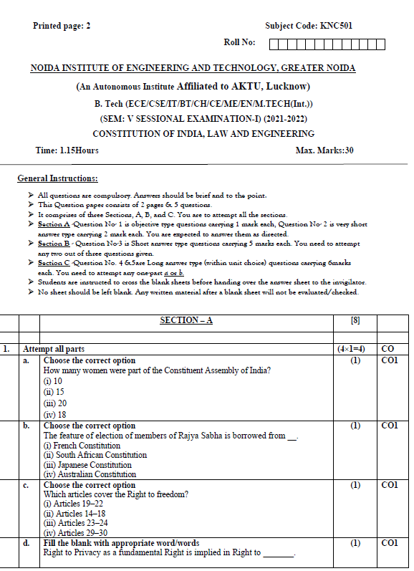
Sessional paper - I

Slide 127
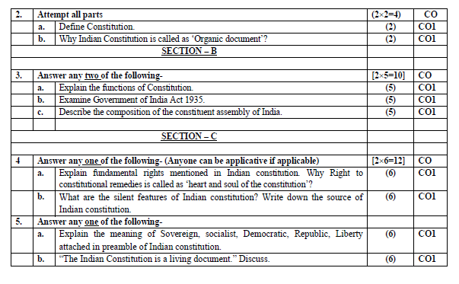
Sessional paper - I

Slide 128
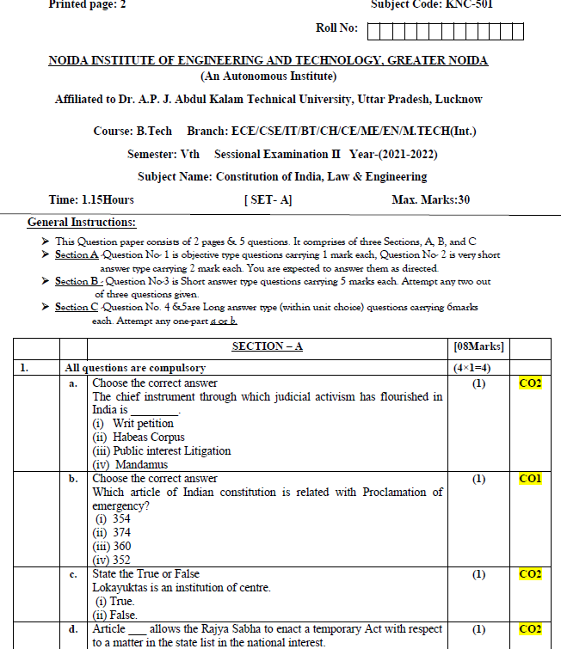
Sessional paper -II

Slide 129
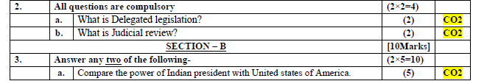
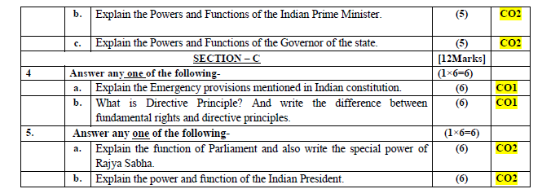
Sessional paper -II

Slide 130
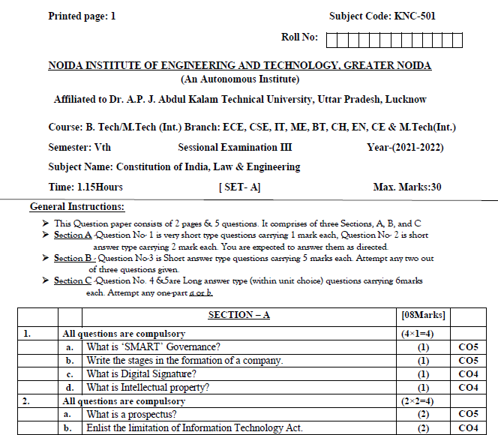
Sessional paper -III

Slide 131
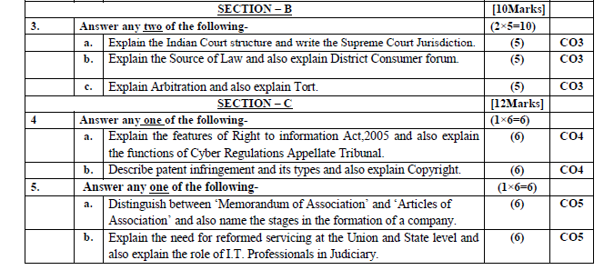
Sessional paper -III

Slide 132
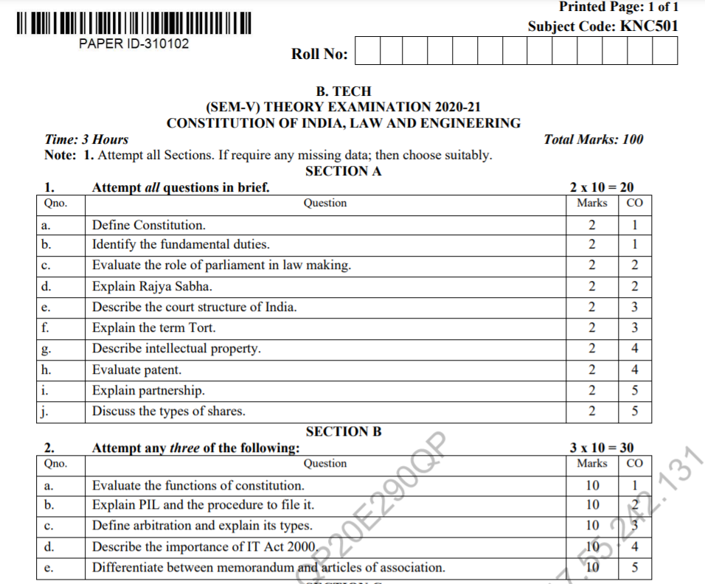
Old Question Papers

Slide 133
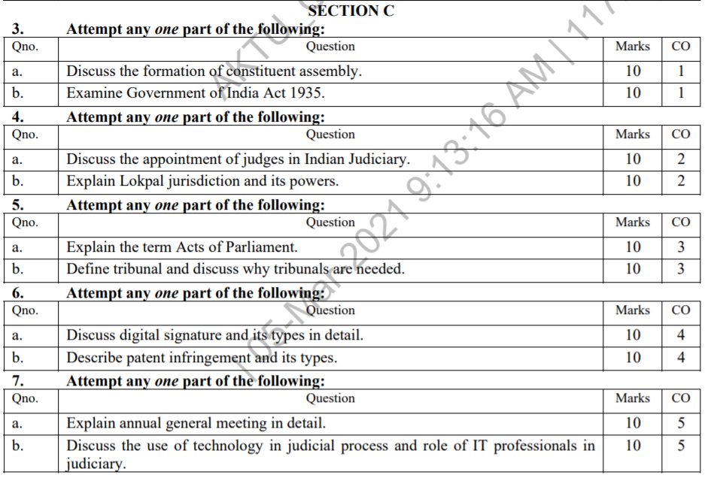
Old Question Papers

Slide 134
Expected Questions for University Exam
What are the powers of Indian Parliament?
Write a short note on Rajya Sabha (Council of States).
Who is the Supreme Commander of India’s armed forces?
On whose recommendations the members of the Council of Ministers appointed?
What is the procedure of removal of the President known as?
How many members of the Rajya Sabha are nominated by the President?
Mention one judicial power of the President.
What type of bills are invariably introduced in the Lok Sabha with the prior approval of the President?
Explain the method of election of the President.
Describe the qualifications for the office of the President of India. What is his and how can he be removed from office?

Slide 135
Expected Questions for University Exam
Compare the powers of Indian President with the United States President.
Write a short note on independence of Supreme Court.
Write a short note on Public Interest Litigation (PIL).
What do you mean by judicial activism? Also mention various methods of judicial activism which are followed in India.
What is Lokpal? Describe the structure of Lokpal.
What is Lok Ayukta? Describe the role of Lok Ayukta.
Explain the powers and functions of the Chief Minister?
What are the powers and functions of State Legislature?

Slide 136
Recap
The Parliament has the power to amend the Constitution of India. Both Houses of the Parliament have equal powers as far as amending the Constitution is concerned. Amendments will have to be passed in both the Lok Sabha and the Rajya Sabha for them to be effective.
Supreme Court at the apex of the Indian Judiciary is the highest authority to uphold the Constitution of India, to protect the rights and liberties of the citizens, and to uphold the values of rule of law. Hence, it is known as the Guardian of our Constitution.

